Slide 1
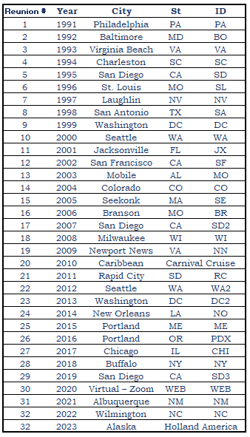
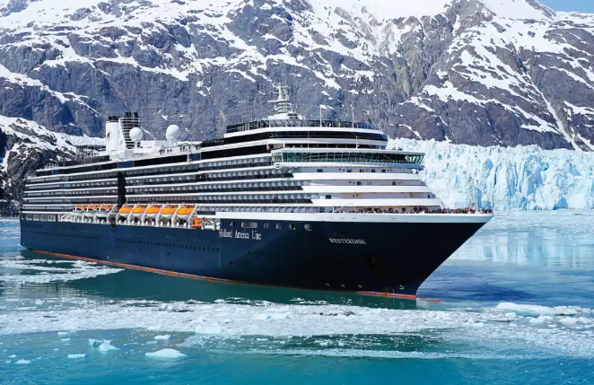
USS Frank Knox
33rd Annual Reunion
September 2-9, 2023
Holland America Alaska Cruise

Slide 2
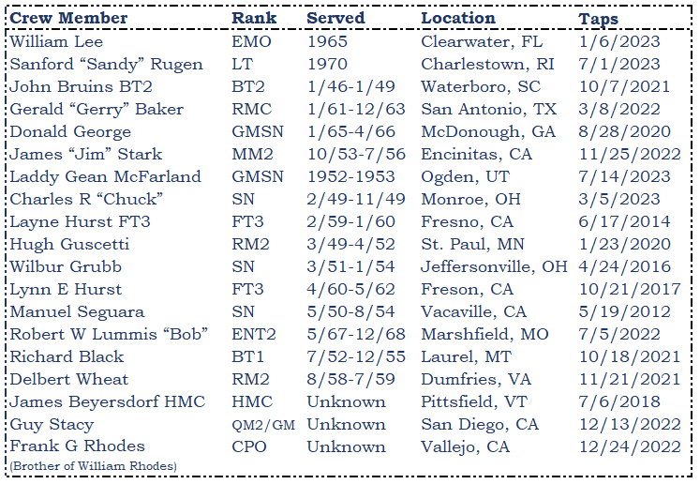
Welcome Aboard! We are excited to spend the next week with you aboard Holland America’s Eurodam. There are several exciting events planned throughout our voyage:
Our welcome reception is tonight (Saturday) 7-9 in Explorations Central, Deck 11. Drinks are available for purchase and included for those with the “Have it All” package. We have a professional photographer coming to take a group photo so dress to impress!
There are two group dinners Sunday and Thursday; arrangements have been made for us to sit together in the main dining room. When checking in, please inform the host you are with the Frank Knox.
The business meeting is Monday 10-12 in the Hudson room (Deck 2). Refreshments will be provided. There will be no auction.
Sit back, enjoy and see you all soon!
Remembering our departed Shipmates
May they rest in peace.

Slide 3
10 Fun Facts about Alaska
North America’s largest glacier (the Bering Glacier) is in Alaska
Alaska is home to North America’s tallest mountain (Denali)
Alaska’s Wildlife includes the world’s largest bear species (Kodiak Bear)
America’s coldest recorded temperature (-80) was in Alaska
Alaska has 394 public airports
Alaska has over 130 volcanoes
Alaska has the longest coastline in the US stretching for 6,640 miles
Dog mushing is Alaska’s state sport
Alaska is known as the “Land of the Midnight Sun”
The only World War II battle on American soil took place in Alaska (the Battle of the Aleutian Islands:
Reunion roster
(Alphabetical by last name and grouped by family)
•Harry* & Joy Chandler
•Jen Chandler, Shellie, Zoey, & Keira McCune (Harry's crew)
•Don Greer*
•George, Connie, & Tara Hatfield; Ronald & Marylin Palmblad; Danielle Johnson & Randy Morales (Don's crew)
•Mike Haloski*
•Yung-Mei Haloski & Luke Michaelson; Alain & Wendy Clerinx (Mike’s crew)
•Bob* & Nancy Hubbard
•Phil* and Bonnie Jenkins
•Cindy Jones
•Vaughan* & Vonja Kruger (daughter)
•Don Landers* & Betsy Wilson
•Suzanne McClanahan & Brion Sellinger (*Lee McClanahan)
•Rick* & Deborah Swaney
•Helen Smith-Tarchalski & Stas Tarchalski (*Ed Smith)
•Wally* & Rhonda Waldorf
•Woody* & Coral Woodard
•Don* & Rebecca Yegge
*Denotes Original Crew member

Slide 4
